Slide 1
Introduction to Computer Science
Welcome to CS111
2022 (Sem 1)

Slide 2

C++ for Everyone by Cay Horstmann
Copyright © 2008 by John Wiley & Sons. All rights reserved

Slide 3
Introduction to Computer Science
Today’s lecture:
Discuss Course Outline
Discuss basic functional components of a computer system, operation and inter- connection.
Discuss Programming!

Slide 4
Course Outline
Refer to Course Outline
C++ for Everyone by Cay Horstmann
Copyright © 2008 by John Wiley & Sons. All rights reserved

Slide 5
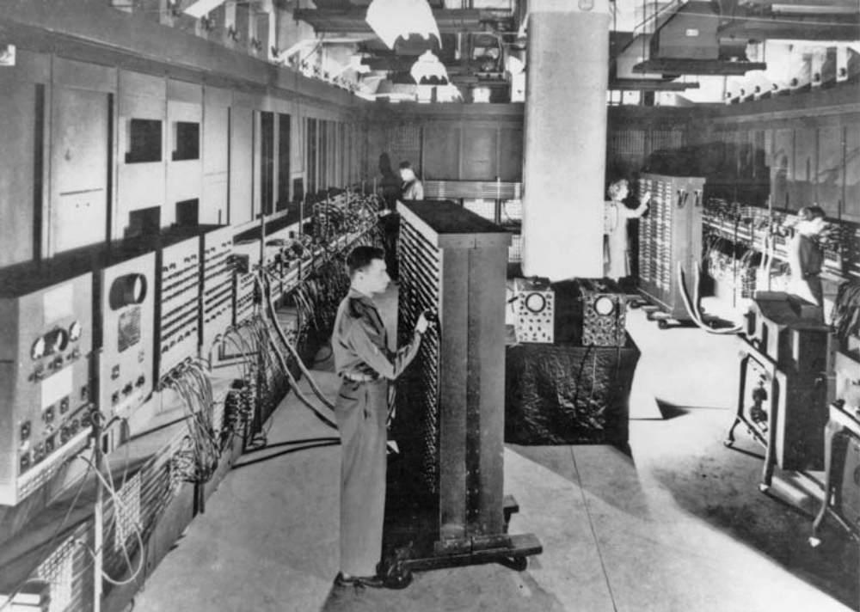
What Is a Computer?
Yes, ALL that is ONE computer!
(except the people)
C++ for Everyone by Cay Horstmann
Copyright © 2012 by John Wiley & Sons. All rights reserved

Slide 6
Computers
Computers execute very basic instructions in rapid succession

Slide 7
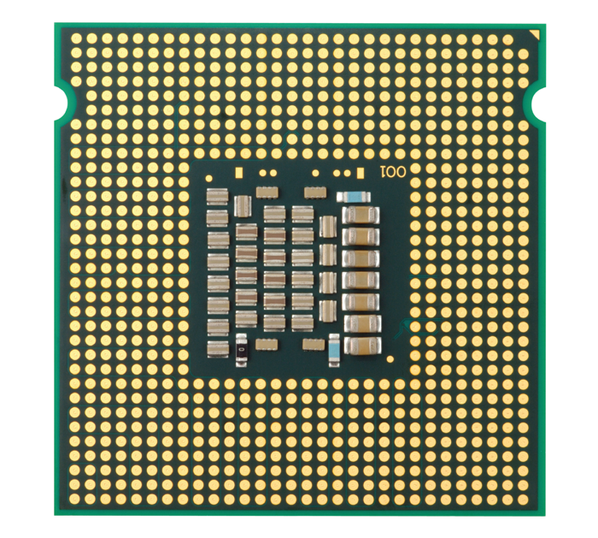
The Anatomy of a Computer – The CPU
The CPU (central processing unit)
  heart of the computer
  performs program control and data processing
C++ for Everyone by Cay Horstmann
Copyright © 2012 by John Wiley & Sons. All rights reserved

Slide 8
Computers
The CPU performs program control and data processing. That is, the CPU
  locates and executes the program instructions;
  it carries out arithmetic operations such as addition, subtraction, multiplication, and division;
  input/output (I/O) operations specified by the instructions in the program

Slide 9
Computers
The computer stores data and programs. There are two kinds of storage.
Primary storage is made from memory chips: electronic circuits that can store data provided they are supplied with electric power.
Secondary storage, usually a hard disk, provides less expensive storage that persists without electricity

Slide 10
Computers – peripheral devices
To interact with a human user, a computer requires peripheral devices. The computer transmits information (called output) to the user through a display screen, speakers, and printers.
The user can enter information (called input) by using a keyboard or a pointing device such as a mouse.

Slide 11
Program
A computer program is a sequence of instructions and decisions.
It tells a computer, in minute detail, the sequence of steps needed to fulfil a task
The programs the computer executes are called the software.

Slide 12
Algorithms
The physical computer and peripheral devices are collectively called the hardware.

Slide 13
Programming
The act of designing and implementing computer programs is called programming..

Slide 14
Algorithms
Algorithm
  A sequence of steps that is unambiguous, executable, and terminating.

Slide 15
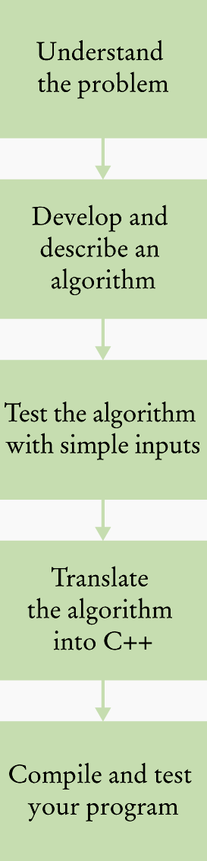
The Software Development Process
For each problem
the programmer goes through these steps

Slide 16
Describing an Algorithm with Pseudocode
Pseudocode
An informal description
An algorithm shouldn't have computer code. Instead, the algorithm should be written in such a way that, it can be used with any programming languages.
Can be written as a series of steps or a flowchart

Slide 17
Describing an Algorithm with Pseudocode
The method described in pseudocode must be
Unambiguous
  There are precise instructions for what
  to do at each step
  and where to go next.
Executable
  Each step can be carried out in practice.
Terminating
  It will eventually come to an end.

Slide 18
Describing an Algorithm with Pseudocode
Consider this problem:
Ask a user for an email address, check and repeatedly ask if email is incorrect.

Slide 19
Step 1: Start
Step 2: Create a variable to store user input
Step 3: clear variable if not empty
Step 4: Ask user for email address
Step 5: Store response in the variable
Step 6: Check the stored response to see if it is a valid email address
Step 7: If not valid, Go back to step 3
Step 8 End

Slide 20
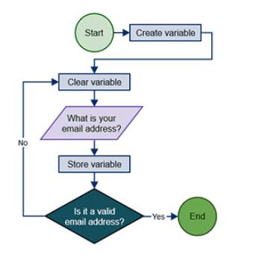
Describing an Algorithm with Pseudocode

Slide 21
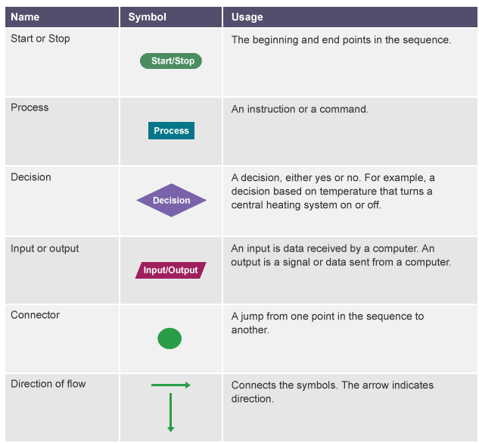
Flowchart symbols
C++ for Everyone by Cay Horstmann
Copyright © 2008 by John Wiley & Sons. All rights reserved

Slide 22
Algorithm 1: Add two numbers entered by the user and display sum
Step 1: Start
Step 2: Declare variables num1, num2 and sum.
Step 3: Read values num1 and num2.
Step 4: Add num1 and num2 and assign the result to sum.
sum←num1+num2
Step 5: Display sum
Step 6: Stop

Slide 23
Describing an Algorithm with Pseudocode
Mom said: Johnny, please go to the market and buy a bottle of milk and if they have eggs, buy 6
Johnny came back with 6 bottles of Milk…..
Why??

